Slide 1

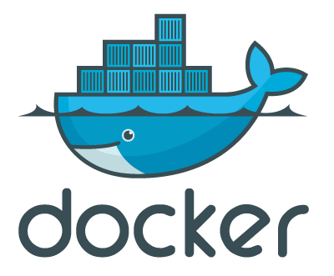
Intro to Docker Containers
Notes:
https://github.com/oracle/cloud-native-devops-workshop/blob/master/containers/docker001/Prerequisites.md
https://github.com/oracle/cloud-native-devops-workshop/blob/master/containers/docker001/Participant-Guide.md#verify-docker-engine-hands-on-lab-environment
https://gist.github.com/benarch/fcd3d98eaa7f6abe951d4d4e7b78e6da
https://hub.docker.com/

Slide 2
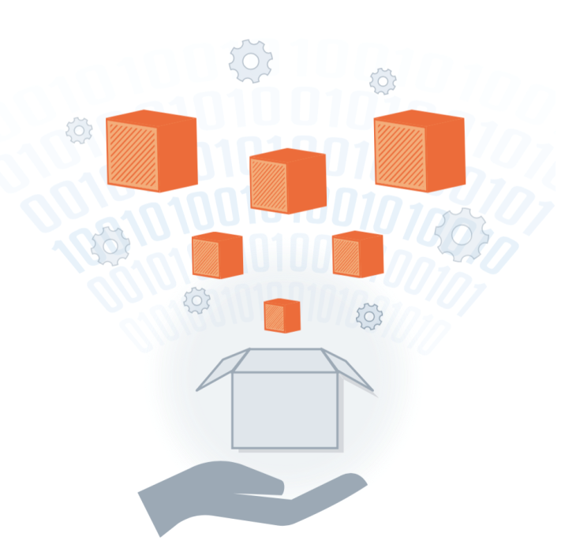
Program Agenda
1
Docker Introduction
Use Cases
Basic Architecture and comparison to VM’s
Why Docker is Hot
Additional Resources
Q&A
2
3
4
5
6
Copyright © 2017 Oracle and/or its affiliates. All rights reserved

Slide 3
Docker Introduction
Copyright © 2017 Oracle and/or its affiliates. All rights reserved

Slide 4
What is Docker?!?
Docker is an Open platform for developers and sysadmins to build, ship and run distributed applications.
It can run on most Linux distributions, Windows and Mac OS running Docker Engine (Toolbox).
It is supported by most of cloud providers and provide a popular Dev/Test, CI & DevOps platform for many use cases.
Copyright © 2017 Oracle and/or its affiliates. All rights reserved
Notes:
Intro to Basic Container Concepts
A container is a runtime instance of a Docker image.
https://docs.docker.com/engine/reference/glossary/#/container
Docker is the company and containerization technology.
https://docs.docker.com/engine/reference/glossary/#/docker

Slide 5
Docker Flow:
Image
Run
Container
Operating System
Software
Application Code
Copyright © 2017 Oracle and/or its affiliates. All rights reserved
Notes:
Docker Run
Containers have a main process
The containers stop when that process stops
Containers have names

Slide 6
Docker Flow:
DockerFile
Image
Run
Container
Build
Copyright © 2017 Oracle and/or its affiliates. All rights reserved

Slide 7
Docker Container Lifecycle
Conception
BUILD an Image from a Dockerfile
Birth
RUN (create+start) a container
Reproduction
COMMIT (persist) a container to a new image
RUN a new container from an image
Sleep
KILL a running container
Wake
START a stopped container
Death
RM (delete) a stopped container
Extinction
RMI a container image (delete image)

Slide 8
Basic Architecture and comparison to VM’s
Copyright © 2017 Oracle and/or its affiliates. All rights reserved

Slide 9
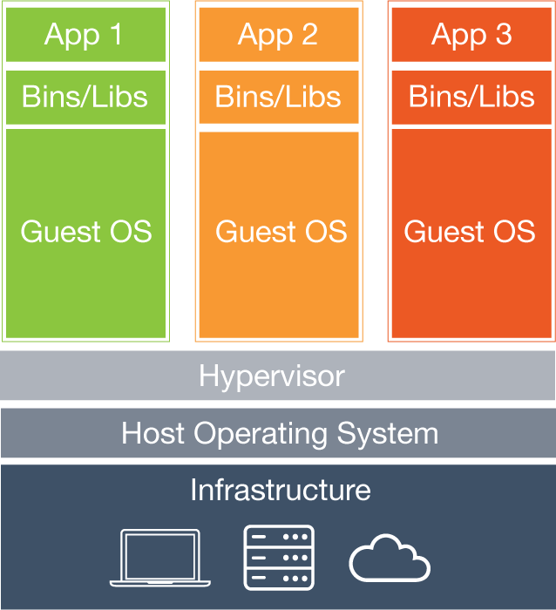
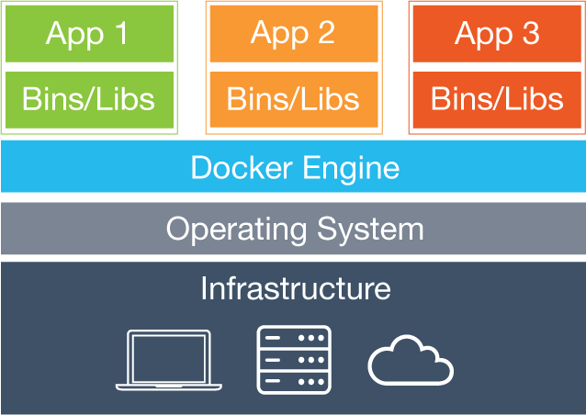
Virtual Machines vs. Containers
Containers
VMs
Virtual Machines
Each virtual machine (VM) includes the app, the necessary binaries and libraries and an entire guest operating system
Containers
Containers include the app & all of its dependencies, but share the kernel with other containers.
Run as an isolated process in userspace on the host OS
Not tied to any specific infrastructure – containers run on any computer, infrastructure and cloud.
Notes:
Now, let's look at how a virtual machine (VM) is different from a container.
While containers may sound like a VM, the two are distinct technologies. With VMs each virtual machine includes the application, the necessary binaries and libraries and the entire guest operating system.
Whereas, Containers include the application, all of its dependencies, but share the kernel with other containers and are not tied to any specific infrastructure, other than having the Docker engine installed on its host – allowing containers to run on almost any computer, infrastructure and cloud.
Note - at this time, Windows and Linux containers require that they run on their respective kernel base, therefore, Windows containers cannot run on Linux hosts and vice versa.

Slide 10
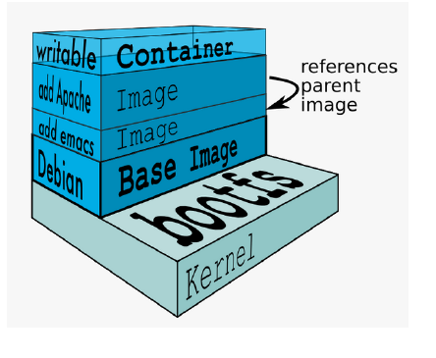
Docker Images
An image is a collection of files and some meta data
Images are comprised of multiple layers, multiple layers referencing/based on another image (Union File System)
Each image contains software you want to run
Every image contains a base layer
Layers are read only
Source: Docker docs and https://docs.docker.com/glossary/
Copyright © 2017 Oracle and/or its affiliates. All rights reserved
Copyright © 2017 Oracle and/or its affiliates. All rights reserved
Notes:
Docker images are a collection of files, which have everything needed to run the software application inside the container. However, they are ephemeral, meaning that any data that is written inside the container, while it is running, will not be retained.
If the container is stopped and restarted from its image, the container will run exactly the same as the first time, absent of any changes made during the last run cycle. Changes to the container either have to be made during the image creation process, using the Dockerfile that become part of the image, or data can be retained by mounting a persistent storage volume, from inside the container to the outside. This will be explored further in the HOL exercises below.

Slide 11
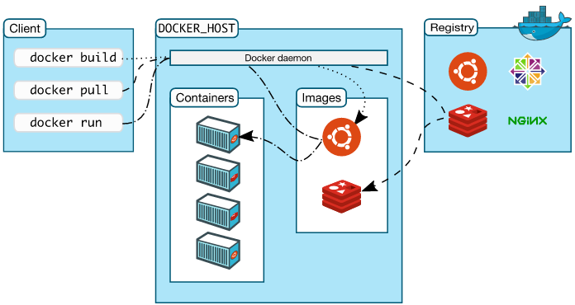
Docker Architecture
Docker client – Command Line Interface (CLI) for interfacing with the Docker
Dockerfile – Text file of Docker instructions used to assemble a Docker Image
Image – Hierarchies of files built from a Dockerfile, the file used as input to the docker build command
Container – Running instance of an Image using the docker run command
Registry – Image repository
Source: Docker docs and https://docs.docker.com/glossary/
Copyright © 2017 Oracle and/or its affiliates. All rights reserved
Notes:
Jumping back a bit, there is a new nomenclature that Docker introduces, here are terms that you will need to be familiar with.
Each of these Docker technologies will be explored in this HOL. It's important to note that this core technology is open source. There are other technologies in the greater ecosystem, that could be open source, or licensed or even a hybrid, with a paid support option.

Slide 12
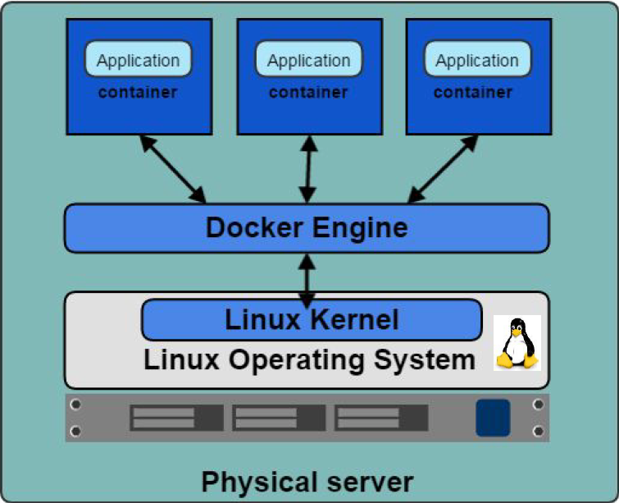
Docker Engine
Container execution and admin
Uses Linux Kernel namespaces and control groups
Namespaces provide for isolated workspace
Source: Docker docs and https://docs.docker.com/glossary/
Copyright © 2017 Oracle and/or its affiliates. All rights reserved
Notes:
The Docker Engine is THE core piece of technology that allows you to run containers. In order for a container to run on any Linux host, at a minimum, the Docker Engine needs to be installed. Then the container can run on any Linux host where Docker Engine is installed, providing the benefit of portability, without doing any application specific configuration changes on each host.

Slide 13
Docker Features….
Light-Weight
Minimal overhead (cpu/io/network)
Based on Linux containers
Decrease storage consumption
Uses layered filesystem to save space (AUFS/LVM)
Portable
Run it Everywhere! - Linux, Mac OS or Windows operating system that has Docker installed.
Raspberry pi support.
Move from one environment to another by using the same Docker technology.
Self-sufficient
A Docker container contains everything it needs to run
Minimal Base OS
Libraries and frameworks
Application code
A Docker container should be able to run anywhere that Docker can run.

Slide 14
Common Terms and commands:
Docker Engine – Docker Deamon, Docker Registry, CLI.
Image – operating systems kernels supplied for a specific instance type / application.
Container – an application running from an image.
DockerFile – a text file with a list of steps to perform to create an image.
Docker Hub – Docker Registry and Repository used for download and share images.
Notes:
Docker Exec
Starts another process in an existing container
Great for debugging and DB administration
Can't add ports, volumes and so on
If I exit from an attached container it will kill the process that is open in other window as well.
Docker logs:
Keep the output of a containers
View with docker logs container_name
Don’t let the output get too large
Resource Constrains:
Memory Limits:
Docker run --memory [maximum-allowed-memory] [image-name] [command]
Example: docker run --memory Srv-001 bash
CPU Limits:
Docker run --cpu-shares (relative to other containers)
Docker run --cpu-quota int (to limit in general)
Orchestration:
Generally requires resource limiting
Recommendations:
Don’t let your container fetch dependencies with their start - make the container include their dependencies inside the container himself.
Don’t leave important things in stopped / unnamed container instances.
Network between containers:
Private Container networking:
Program in containers are isolated from the internet by default
You can group your containers into "Private" networks.
You explicitly choose who connect to whom.
This is done by "exposing" ports and "linking" containers.
Docker helps you find other exposed ports with compose services.
Exposing specific ports:
Exactly specifies which the port inside the container and outside.
Exposes as many ports as you want.

Slide 15
Dockerfile ……
• Like a Makefile (shell script with keywords)
• Extends from a Base Image
• Results in a new Docker Image
• Imperative, not Declarative
A Docker file lists the steps needed to build an images
• docker build is used to run a Docker file
• Can define default command for docker run, ports to expose, etc

Slide 16
Dockerfile – Text file (recipe) used to create Docker images
# Set the base image to Ubuntu
FROM ubuntu
# File Author / Maintainer
MAINTAINER Maintaner Name
# Install Nginx
# Update the repository
RUN apt-get update
# Install necessary tools
RUN apt-get install -y nano wget dialog net-tools
# Download and Install Nginx
RUN apt-get install -y nginx
Example Hello World Dockerfile
Copyright © 2017 Oracle and/or its affiliates. All rights reserved
Oracle Confidential – Restricted

Slide 17
# Remove the default Nginx configuration file
RUN rm -v /etc/nginx/nginx.conf
# Copy a configuration file from the current directory
ADD nginx.conf /etc/nginx/
# Append "daemon off;" to the beginning of the configuration
RUN echo "daemon off;" >> /etc/nginx/nginx.conf
# Expose ports
EXPOSE 80
# Set the default command to execute
# when creating a new container
CMD service nginx start

Slide 18
How to Build a Docker image
Docker build –t <image name> .

Slide 19
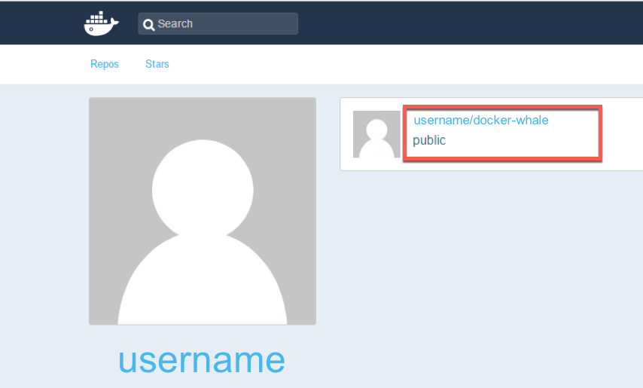
Docker Hub
Docker Inc.
Repository
public and private images
Enables images to be shared and moved off the laptop
Example usage:
$ docker tag docker-whale:latest username/docker-whale:latest
$ docker push username/docker-whale:latest
$ docker pull username/docker-whale:latest
Copyright © 2017 Oracle and/or its affiliates. All rights reserved

Slide 20
Docker CLI – Common / useful commands
docker build : build docker image from Dockerfile
docker run : run docker image
docker logs : show log data for a running or stopped container
docker ps : list running docker containers (analogous to ps)
docker ps –a : list all containers including not running
docker images : list all images on the local volume
docker rm : remove/delete a container | docker rmi : remove/delete an image
docker tag : name a docker image
docker login : login to registry
docker push/pull : push or pull volumes to/from Docker Registries
docker inspect : return container run time configuration parameter metadata
See the docs here: https://docs.docker.com/edge/engine/reference/commandline/docker/
Copyright © 2017 Oracle and/or its affiliates. All rights reserved

Slide 21
Docker Run
Pulls the image and runs it as a container
Examples:
Simple:
$ docker run hello-world
Complex:
$ docker run -d --restart=always -p 80:80 –name nginx image_id
How to enter inside:
$ docker exec –ti nginx bash
Copyright © 2017 Oracle and/or its affiliates. All rights reserved

Slide 22
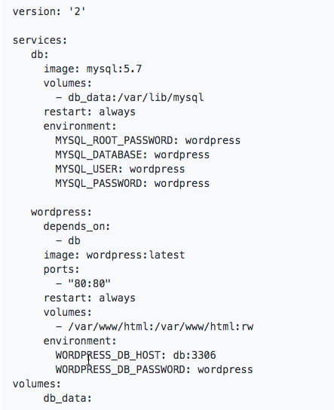
Docker Compose
Docker Compose
Docker Tool for defining and running multi-container Docker applications
Reference file defined in YAML
docker-compose.yml
$ docker-compose up -d
Copyright © 2017 Oracle and/or its affiliates. All rights reserved
Notes:
Running multi container environment for multiple purposes:
Mail (Messaging) Server
Web Server + DB
Caching
Docker compose is written in YAML
Dingle command to manage all services

Slide 23
Why Docker is Hot
Copyright © 2017 Oracle and/or its affiliates. All rights reserved

Slide 24


Why Docker is Hot – Its simple, Devs love it
Dev/Test of Legacy Apps
New App Dev (including parts of legacy apps)
Code Agility, CI/CD Pipeline, DevOps
Adoption of Open Source
Microservices & Cloud Native Apps
Copyright © 2017 Oracle and/or its affiliates. All rights reserved
Notes:
Additionally, in speaking with hundreds of organizations that are exploring and using Docker, these are the core advantages that Docker brings.

Slide 25
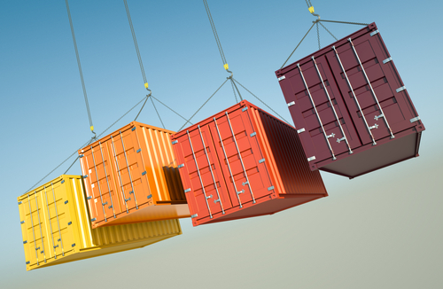
Why Containers?
Developers care because:
IT cares because:
Quickly create ready-to-run packaged applications, low cost deployment and replay
Automate testing, integration, packaging
Reduce / eliminate platform compatibility issues (“It works in dev!”)
Support next gen applications (microservices)
Improve speed and frequency of releases, reliability of deployments
Makes app lifecycle efficient, consistent and repeatable – configure once, run many times
Eliminate environment inconsistencies between development, test, production
Improve production application resiliency and scale out / in on demand
Copyright © 2017 Oracle and/or its affiliates. All rights reserved
Notes:
Ok, so those are some of the mechanics of the technology, but why is Docker popular among all types of IT people? Let's look at these proof points from Developers and IT Ops.

Slide 26
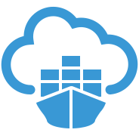
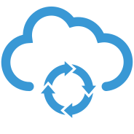
The Docker DevOps Cycle
Plan
Code
Build
Release
Deploy
Test
Operate
Monitor
OPC services featuring:
Oracle Developer Cloud Service
Now Includes Docker Image Build Function*
Oracle Container Cloud Service
Deploy, Operate, Monitor
Container CS
Dev CS
Copyright © 2017 Oracle and/or its affiliates. All rights reserved

Slide 27
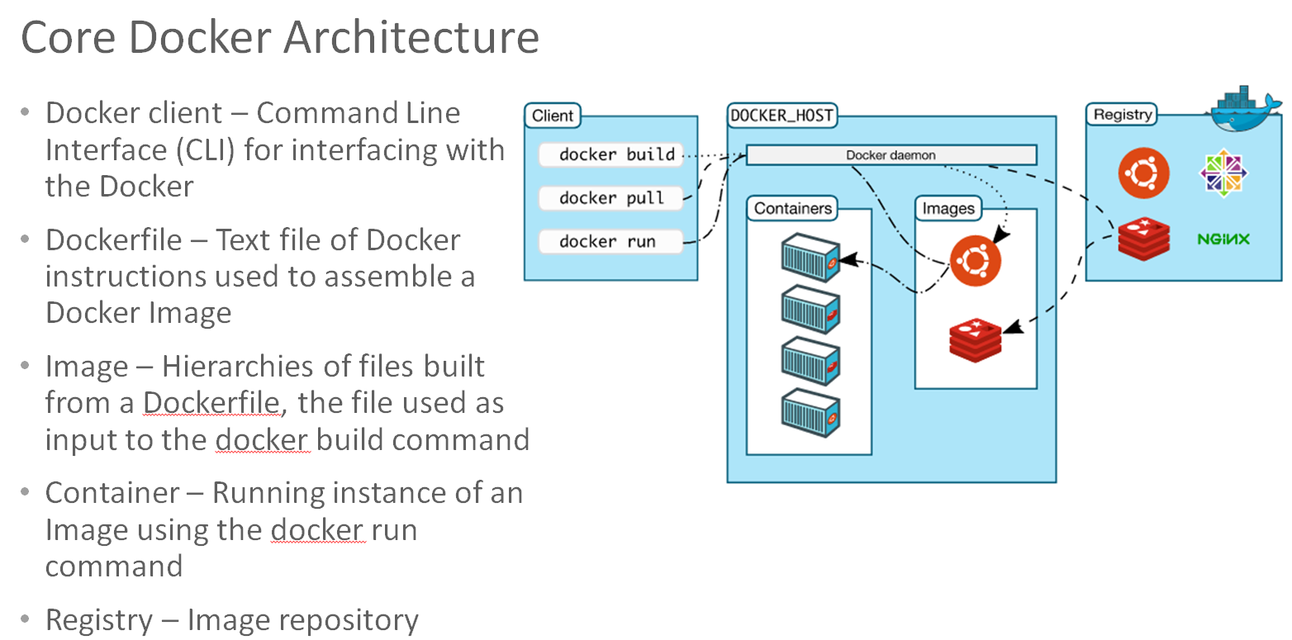
Containers are Portable, but How about Advanced Functions
Advanced Functions
Orchestration, Monitoring, Operations, Service Discovery
Docker Environment Provisioning
Fragmented Market Solutions
Kubernetes
Swarm, Docker Data Center, Docker Cloud
Consul, ETCD, Docker Networking
etc
+
Copyright © 2017 Oracle and/or its affiliates. All rights reserved

Slide 28
Use Cases
Copyright © 2017 Oracle and/or its affiliates. All rights reserved

Slide 29
Excellent Use Cases for Containers
Ready to Run Application Stacks
Excellent for Dev/Test setups
Deployment in Seconds, not Hours/Days
Start Up, Tear Down Quickly
Front-End App Servers
Highly horizontally scalable
Cattle Not Pets
Fast A/B, Rolling Deployments
Optimize CX
Traditional Technologies - MW/Backend
New App Dev & Microservices
Refactor all or part of legacy app
Containers are great for Microservices
Server Density
Containers can use dynamic ports
Run many of the same app on a server
instead of one per VM
One-Time Run Jobs and Analytics
Run the Job / Analysis and quit
Copyright © 2017 Oracle and/or its affiliates. All rights reserved

Slide 30
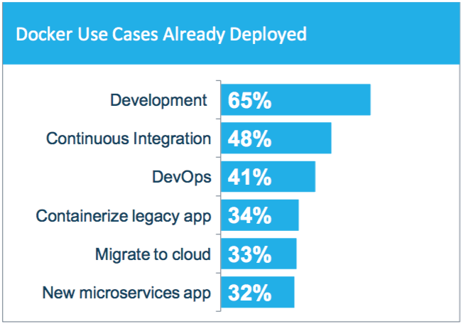
How Containers are Being Used – Survey Says:
Developer productivity a top use case today
Building out CI/CD pipelines
Consistent container image moves through pipeline
Preventing “it worked in dev” syndrome
Application modernization and portability are also key adoption drivers (Prem <-> cloud)
SOURCE: THE EVOLUTION OF THE MODERN SOFTWARE SUPPLY CHAIN, DOCKER SURVEY 2016
Copyright © 2017 Oracle and/or its affiliates. All rights reserved

Slide 31
Common Terms and commands:
Tag – give a name to an image.
Compose – create multi container application tier for running a service / stack. Done by running a YAML file.
Exec – starts another process in an existing container (commonly used for debugging, DB administration, etc..
Logs – keeps the output of a containers.
Swarm – Docker Cluster features and Orchestration.
Notes:
Docker Exec
Starts another process in an existing container
Great for debugging and DB administration
Can't add ports, volumes and so on
If I exit from an attached container it will kill the process that is open in other window as well.
Docker logs:
Keep the output of a containers
View with docker logs container_name
Don’t let the output get too large
Resource Constrains:
Memory Limits:
Docker run --memory [maximum-allowed-memory] [image-name] [command]
Example: docker run --memory Srv-001 bash
CPU Limits:
Docker run --cpu-shares (relative to other containers)
Docker run --cpu-quota int (to limit in general)
Orchestration:
Generally requires resource limiting
Recommendations:
Don’t let your container fetch dependencies with their start - make the container include their dependencies inside the container himself.
Don’t leave important things in stopped / unnamed container instances.
Network between containers:
Private Container networking:
Program in containers are isolated from the internet by default
You can group your containers into "Private" networks.
You explicitly choose who connect to whom.
This is done by "exposing" ports and "linking" containers.
Docker helps you find other exposed ports with compose services.
Exposing specific ports:
Exactly specifies which the port inside the container and outside.
Exposes as many ports as you want.

Slide 32



Questions?

